Slide 1

Health Care Analytics

Slide 2
Group 5
LAVANYA VALLIMANALAN
Tarun Kumar K
Madhura Shantaram Jadhav
Satyajit Pattanayak
Vinay N
KANCHAR SAI REDDY
M. Navadeep

Slide 3
Summary
Patient Healthcare Analytics is a data analysis project focused on understanding patient visits, doctor workload, treatments, healthcare costs, and laboratory results. The project uses healthcare data to create meaningful KPIs and dashboards that help monitor overall healthcare operations and patient-related information.

Slide 4
Project Objective
Analyze patient and healthcare service information.
Monitor the number of patients, doctors, and visits.
Understand common diagnosed conditions.
Analyze follow-up requirements.
Monitor treatment costs.
Track laboratory tests and abnormal results.
Understand doctor workload.
Present the information through clear KPIs and visual dashboards.

Slide 5
KPI List
Total Patients
Total Doctors
Total Visits
Average Age of Patients
Top 5 Diagnosed Conditions
Follow-Up Rate
Average Treatment Cost Per Visit
Total Lab Tests Conducted
Abnormal Lab Results %
Doctor Workload

Slide 6
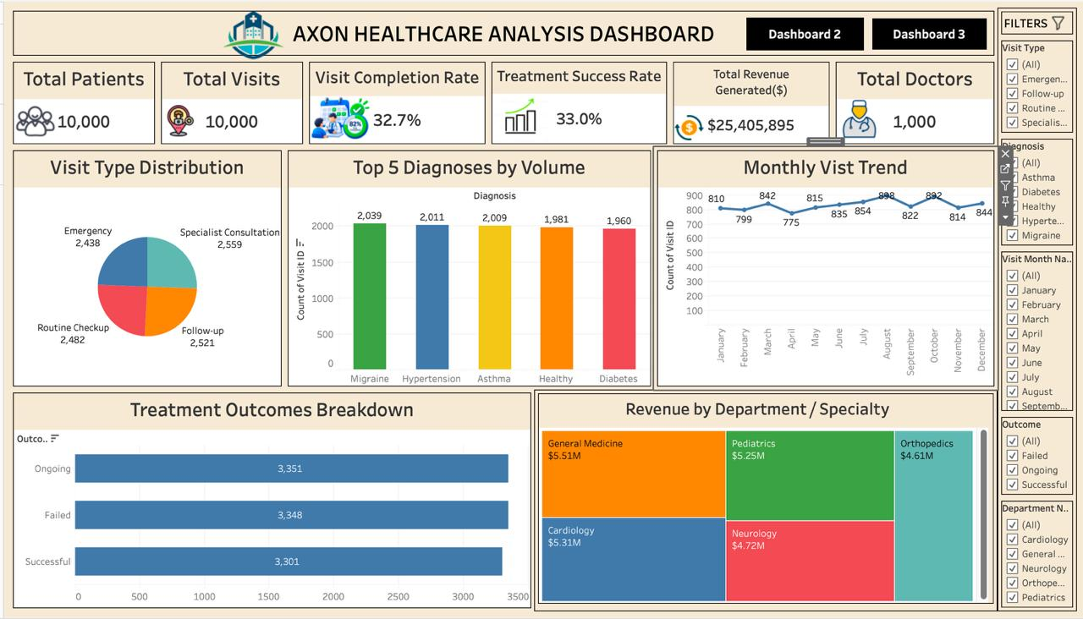
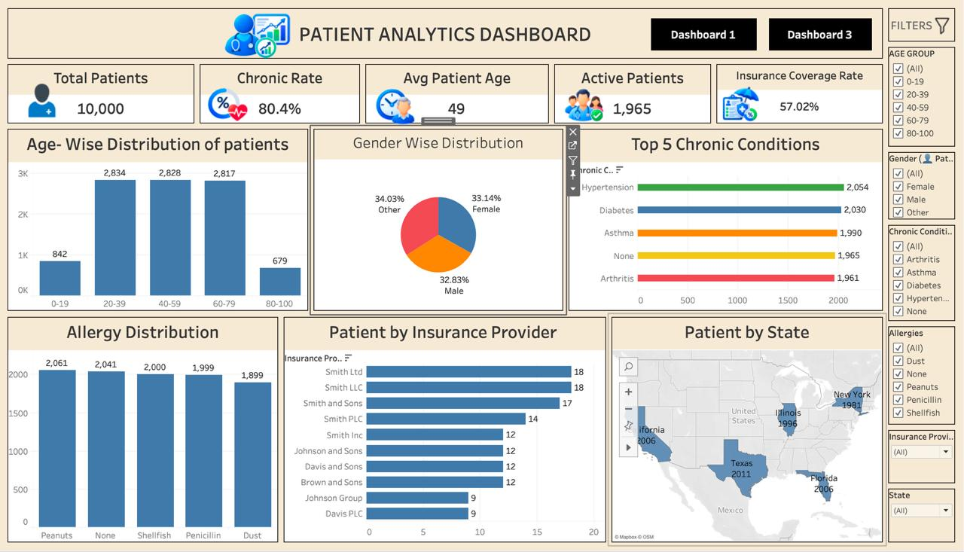
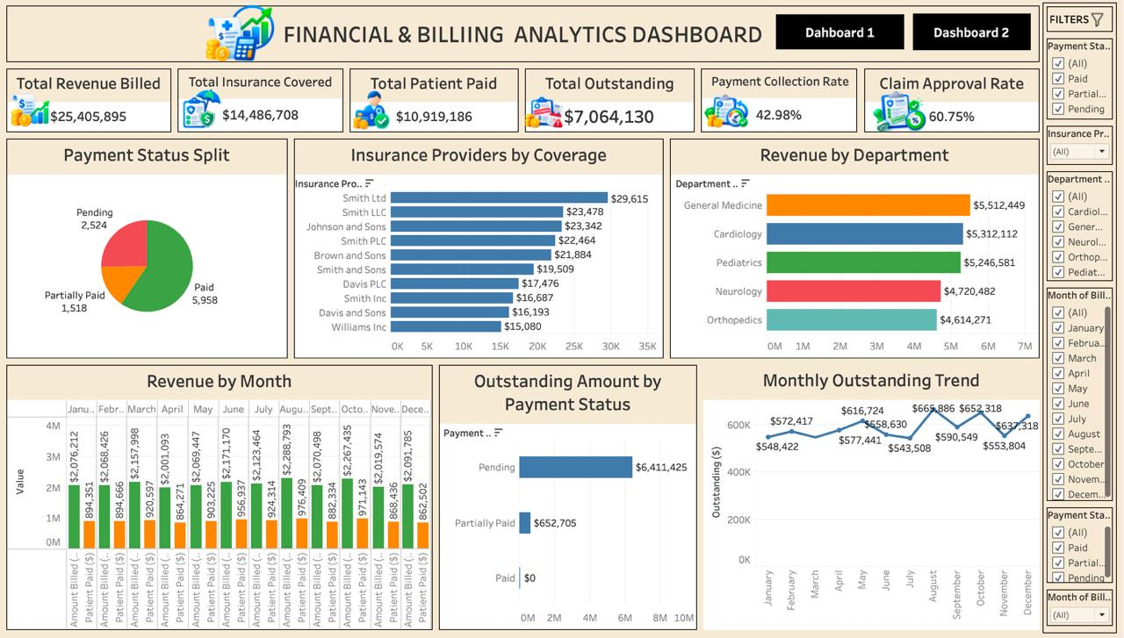
Tableau Dashboard

Slide 7
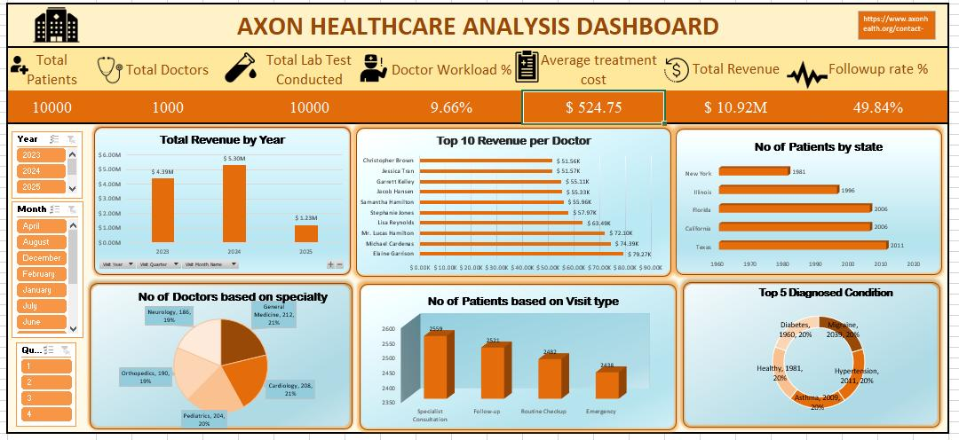
Excel Dashboard

Slide 8
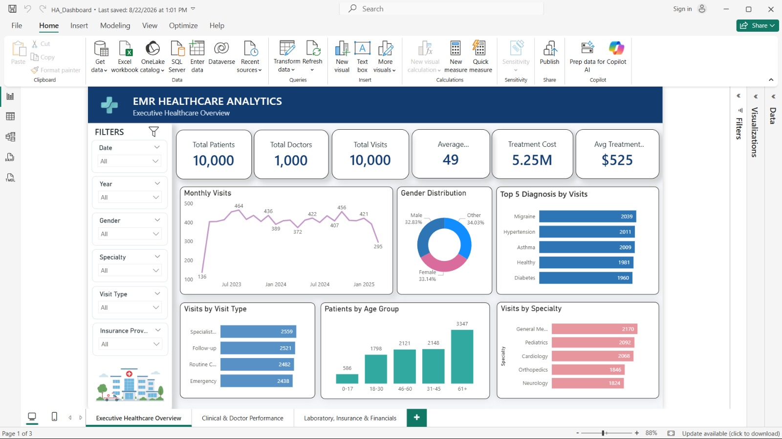
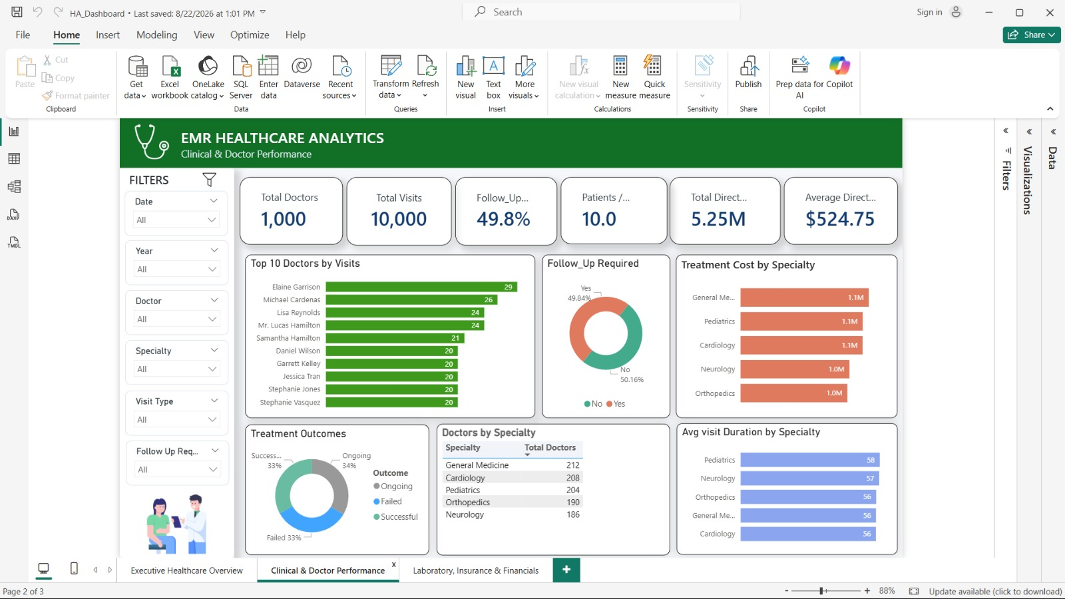
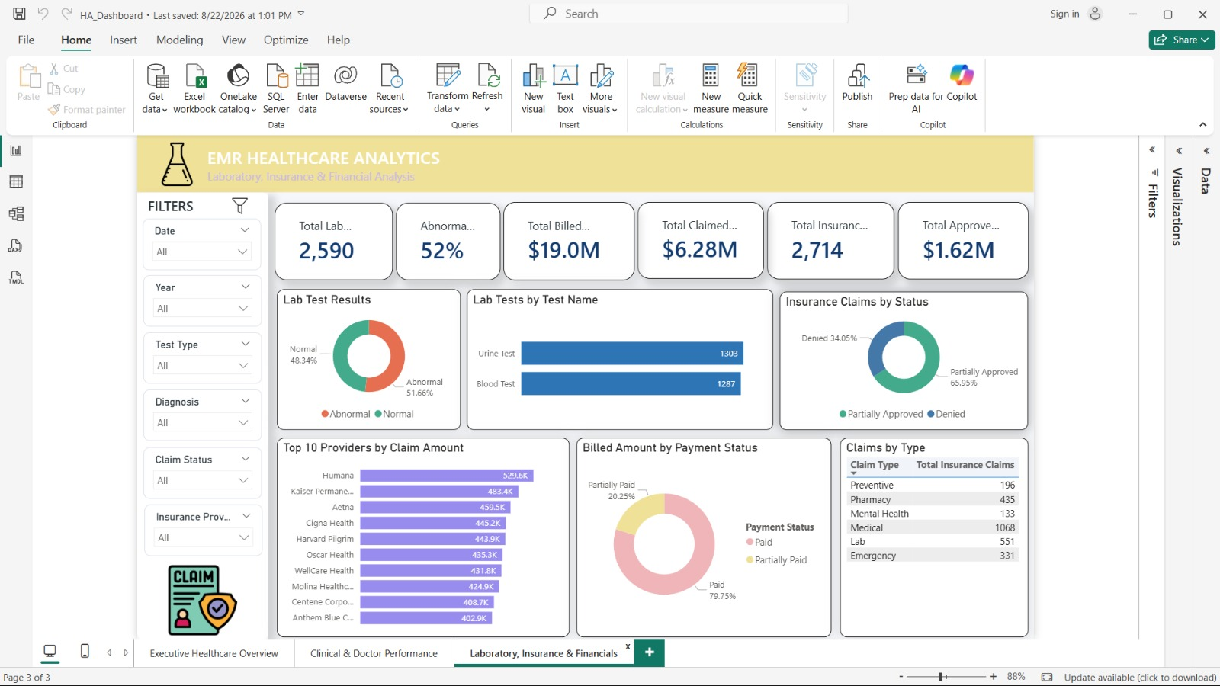
Power BI Dashboard

Slide 9
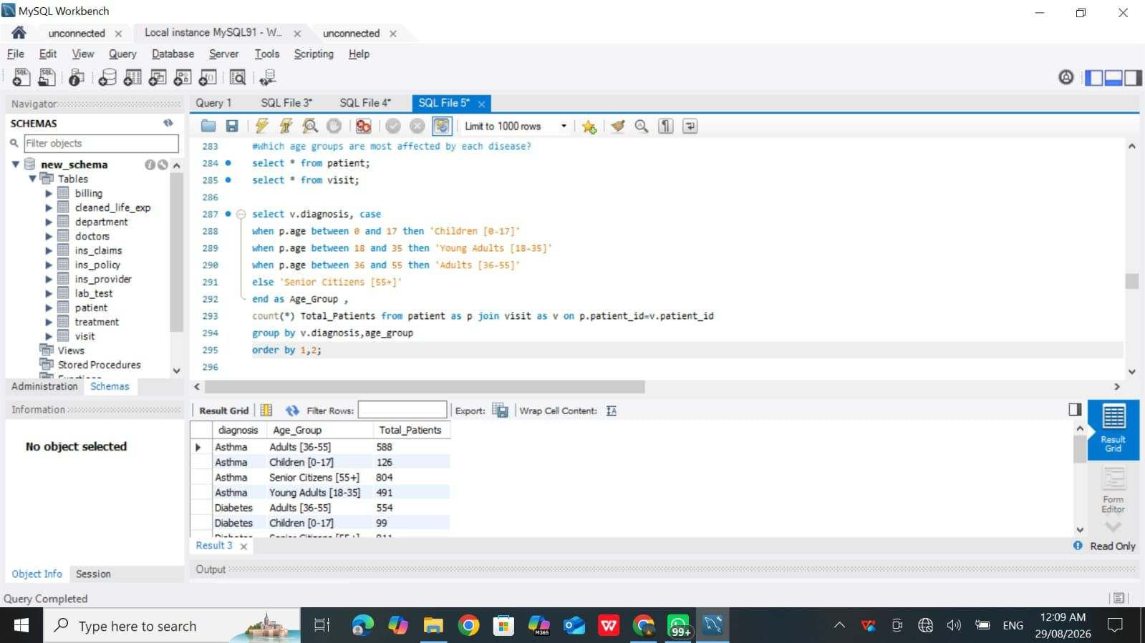
SQL Queries

Slide 10
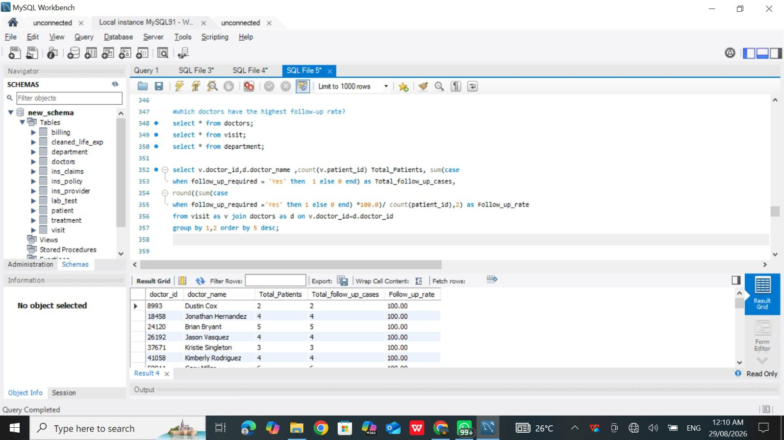

Slide 11
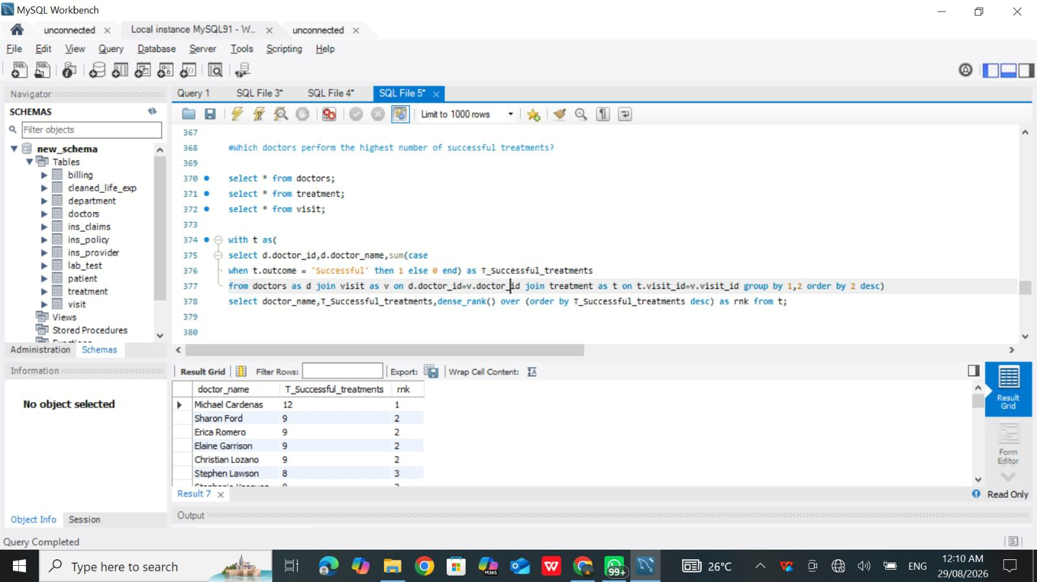

Slide 12
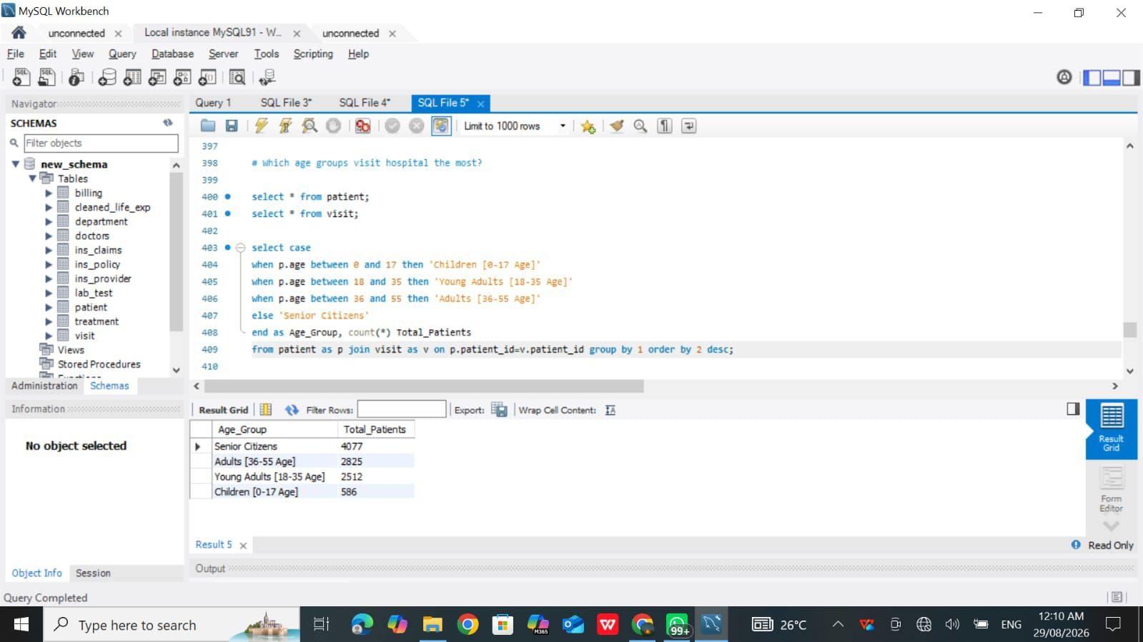

Slide 13
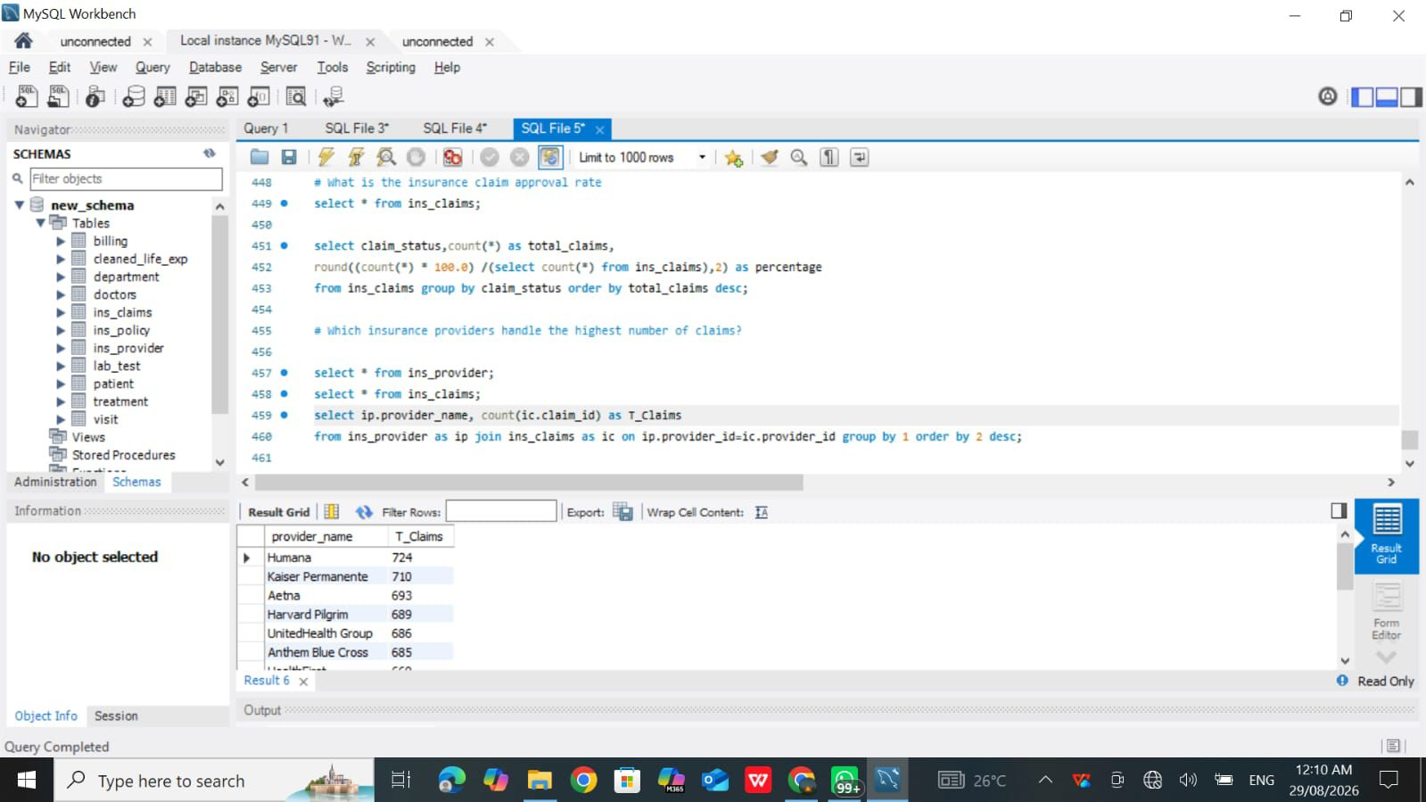

Slide 14
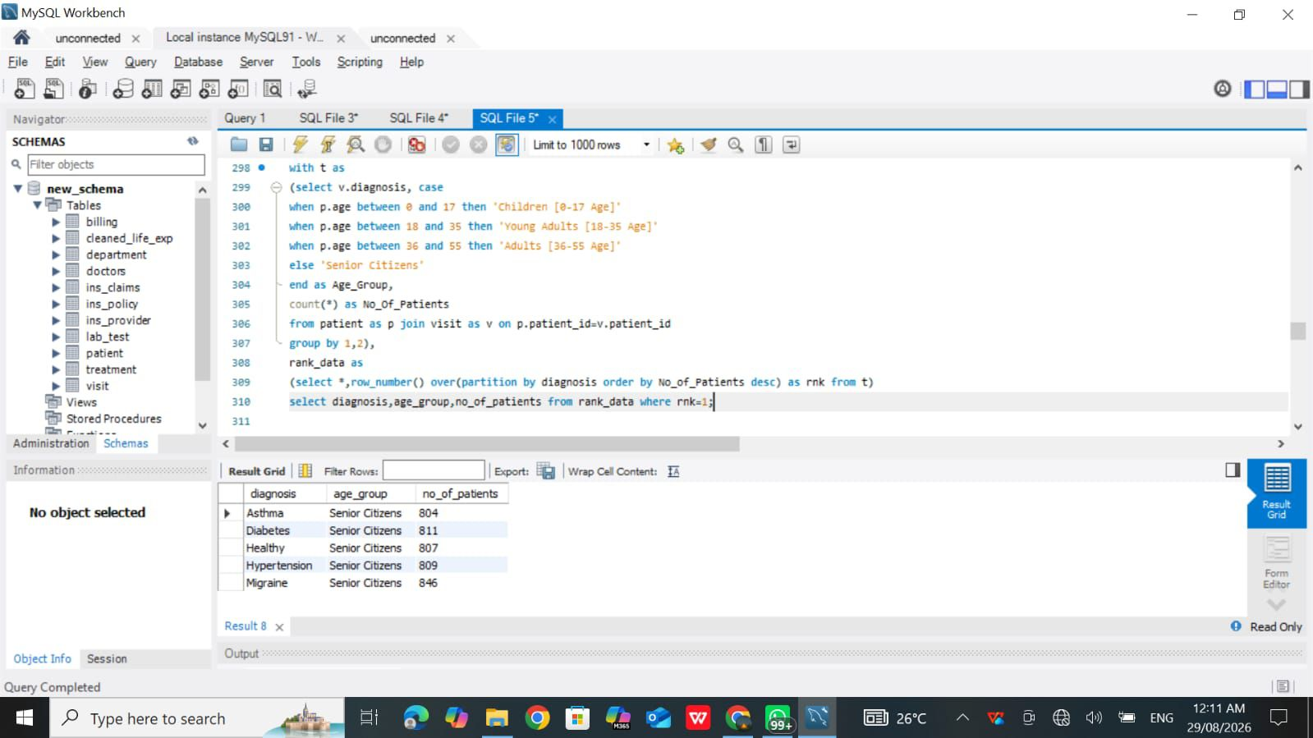

Slide 15
Conclusion
The Patient Healthcare Analytics project provides a clear overview of healthcare operations by analyzing patients, doctors, visits, diagnoses, treatments, costs, and laboratory results. The use of KPIs and dashboards makes it easier to monitor important healthcare performance indicators such as patient volume, follow-up rate, treatment cost, abnormal lab results, and doctor workload.

Slide 16
Thank You…

